Slide 1
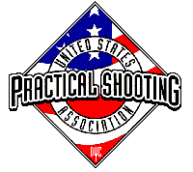
Stage 2/Bay 2 Stakeout Squad Standards Course Designer: Eric Beerbaum
Stakeout Squad Standards is a 24 round, 120 point Virginia Count Standards Exercise.. There are 6 USPSA targets. The best four hits per target will score. The start signal is audible.
The Handgun start position is hands touching both upper marks. Handgun is loaded and holstered. The PCC start position is PCC loaded, safety on, stock touching belt, muzzle touching bottom mark.
String 1: On the audible start signal engage T1-T3 (the back targets) with two rounds each, freestyle. Conduct a mandatory reload and engage T4-T6 (the front targets) with two rounds each, strong hand/shoulder only. String 2: On the audible start signal engage T1-T3 (the back targets) with two rounds each, freestyle. Conduct a mandatory reload and engage T4-T6 (the front targets) with two rounds each, weak hand/shoulder only.

Slide 2
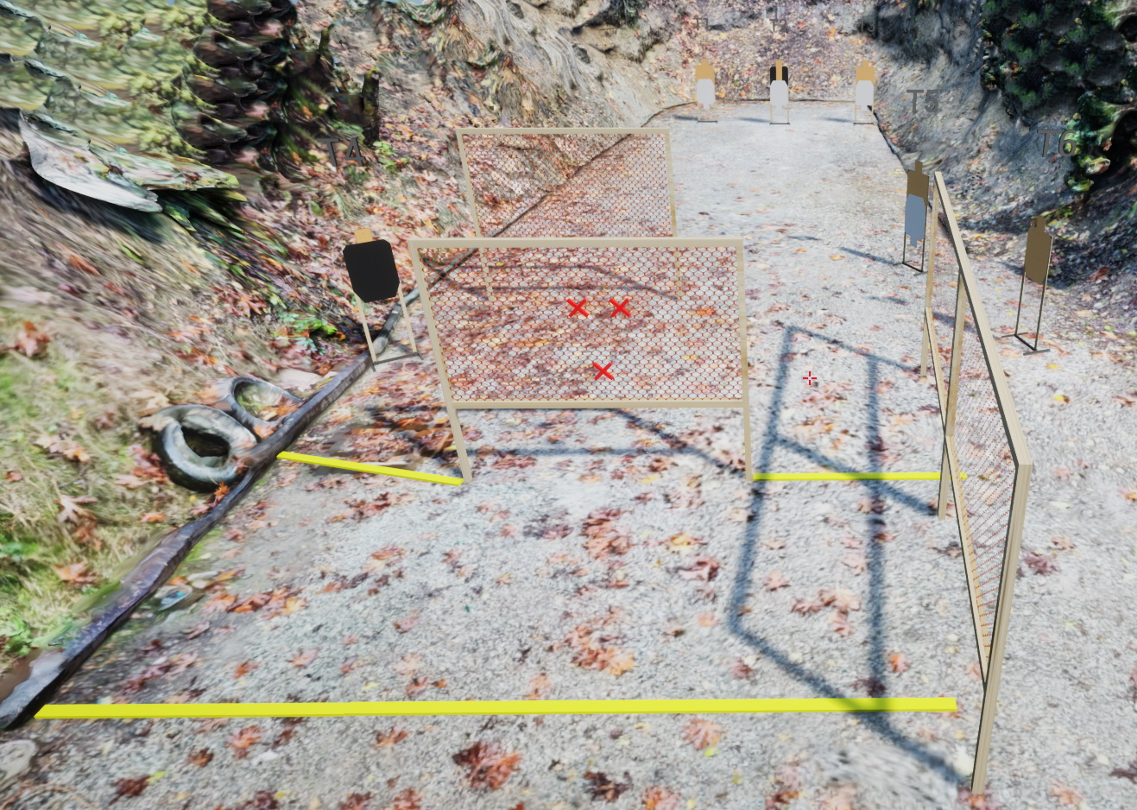
 | Stage 2/Bay 2 Stakeout Squad Standards Course Designer: Eric Beerbaum

